Slide 1
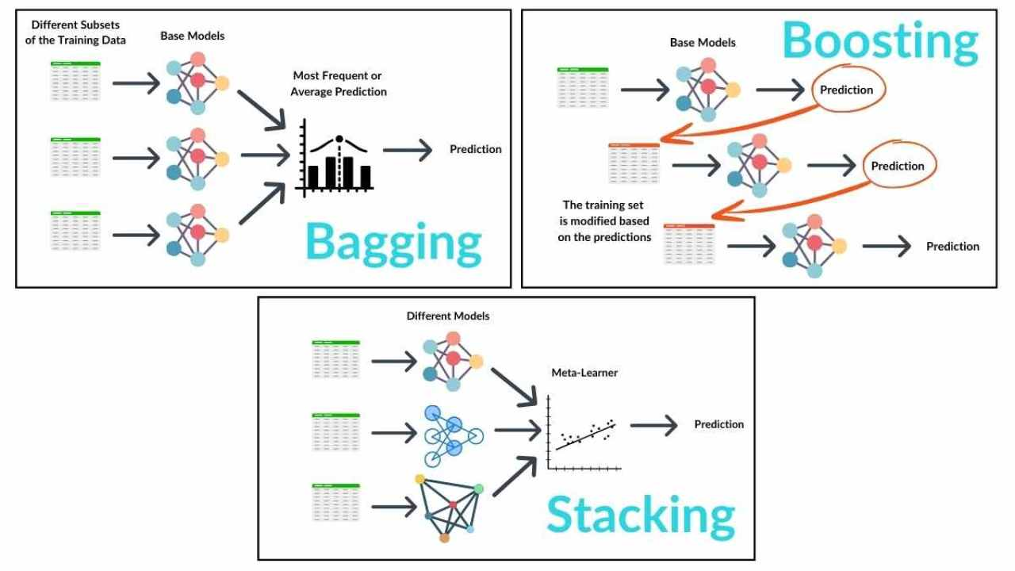
Ensemble Learning

Slide 2
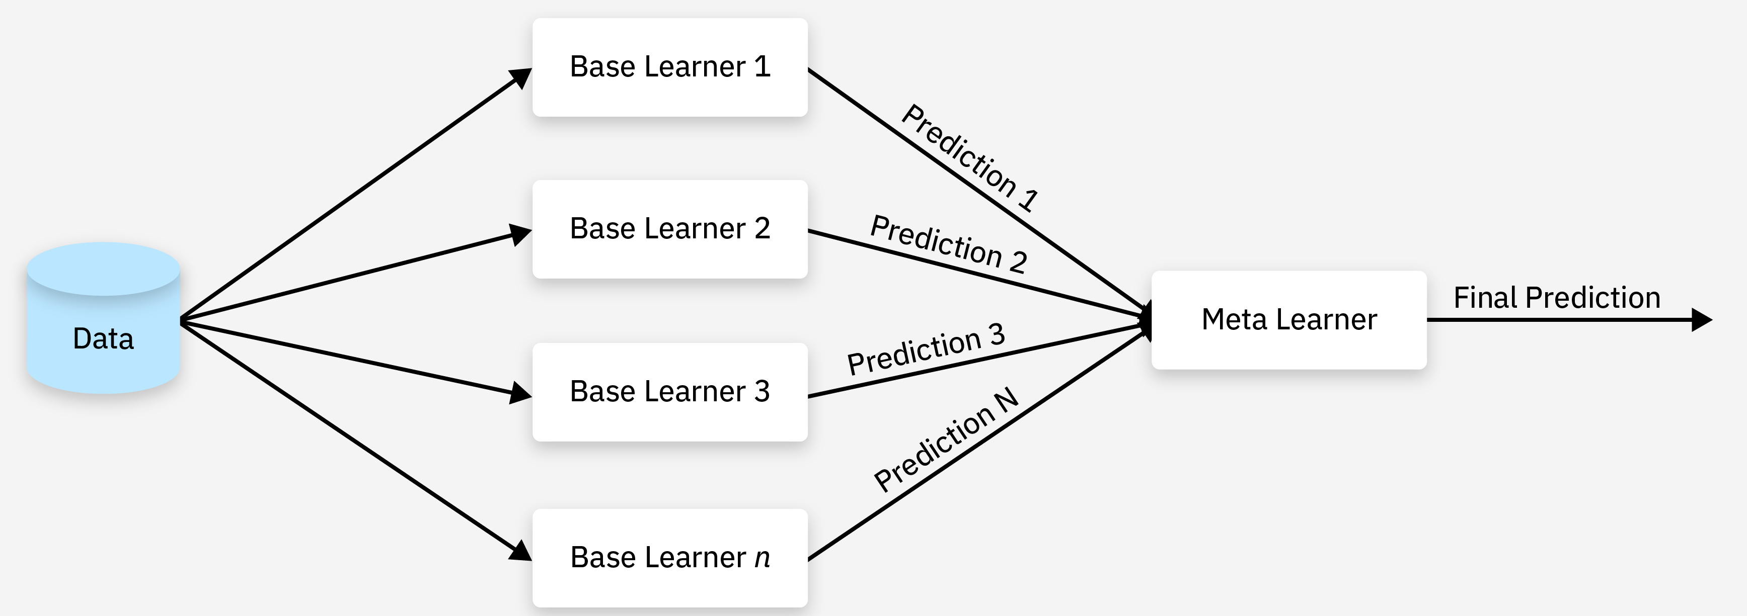
Ensemble Learning
Ensemble Learning is a machine learning technique where multiple models (called weak learners) are combined to form a stronger and more accurate model. Imagine asking multiple experts for their opinions and combining their insights to make a final decision. That’s the core idea of ensemble learning.

Slide 3
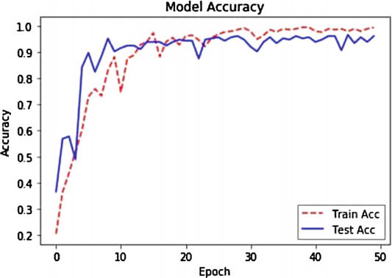
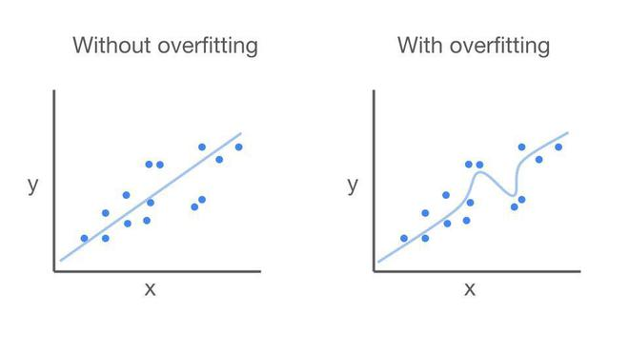
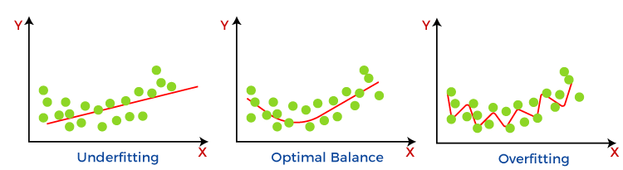
Why Use It?
Increases accuracy
Reduces overfitting
Improves generalization

Slide 4
Types of Ensemble Learning
Type | Description | Popular Algorithms
Bagging | Models are trained independently in parallel on random subsets of data | Random Forest
Boosting | Models are trained sequentially, and each new model corrects the previous one | AdaBoost, Gradient Boosting
Stacking | Different models are trained and then combined using a meta-model | Blend of models + final learner

Slide 5
Applications
Domain | Use Case
🛒 E-commerce | Customer segmentation, recommendation engines
💳 Finance | Credit scoring, fraud detection
🏥 Healthcare | Disease prediction, patient risk assessment
📈 Marketing | Predicting customer churn
📊 Data Science | Kaggle competitions (widely used model)
🔍 Search Engines | Ranking search results

